Slide 1

A machine learning algorithm for binary classification of gender bias in text
Classifier - DA2

Slide 2

Contents
Problem statement
Possible solution identification
Best fit algorithm selection
Developing the model
Results and discussion
Clussion
References

Slide 3
Problem statement
In this problem, a set of pairs of text is given as dataset.
The end goal is to determine if they are similar or dissimilar based on some form of gender bias in the text.
The forms of the gender bias could be -
i) firstness: where a gender (male/female) is always mentioned first
ii) stereotyping of a particular gender
iii) subordination: where the text reflects a gender is subordinate compared to other
0
If both biased or both unbiased
Find the similarity and dissimilarity based on gender bias
A set of text pair
Binary classification
1
One is biased but the other unbiased

Slide 4
Possible solution identification
Machine Learning (ML) has become a vast umbrella of various algorithms. Certainly, even for classification models, there are numerous algorithms such as -
Logistic Regression
Naïve Bayes Classifier
K-Nearest Neighbors

Slide 5
Best fit algorithm selection - KNN
Algorithm Selection justification -
The proposed works present a comparative study of various binary classifier
It is observed that KNN is giving better result
So KNN have implemented from various binary classification algorithms

Slide 6
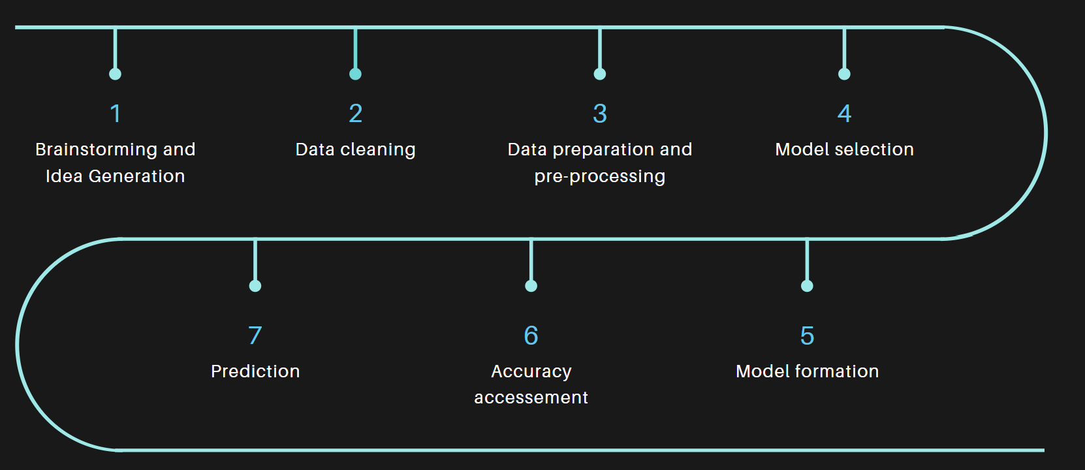
Approach to solve the problem

Slide 7

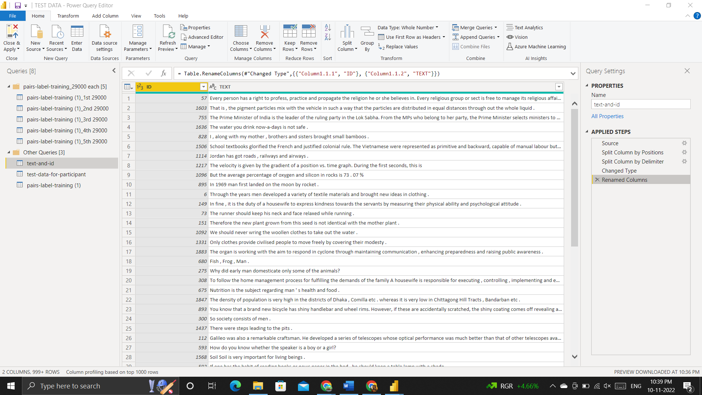
Developing the model - Data Cleaning
Structuring the test dataset

Slide 8
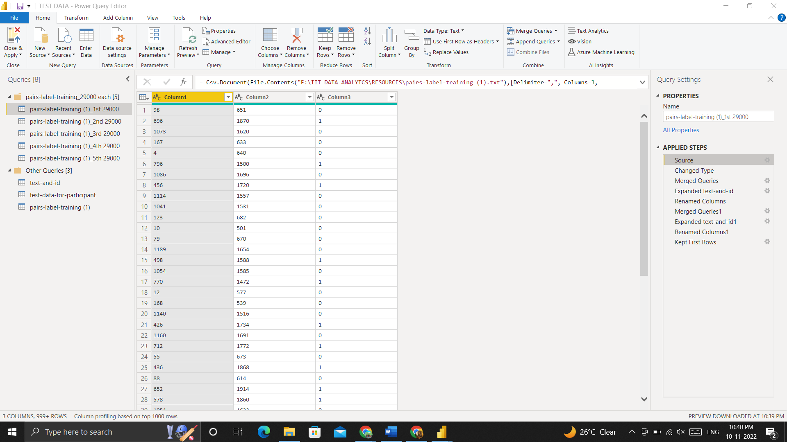
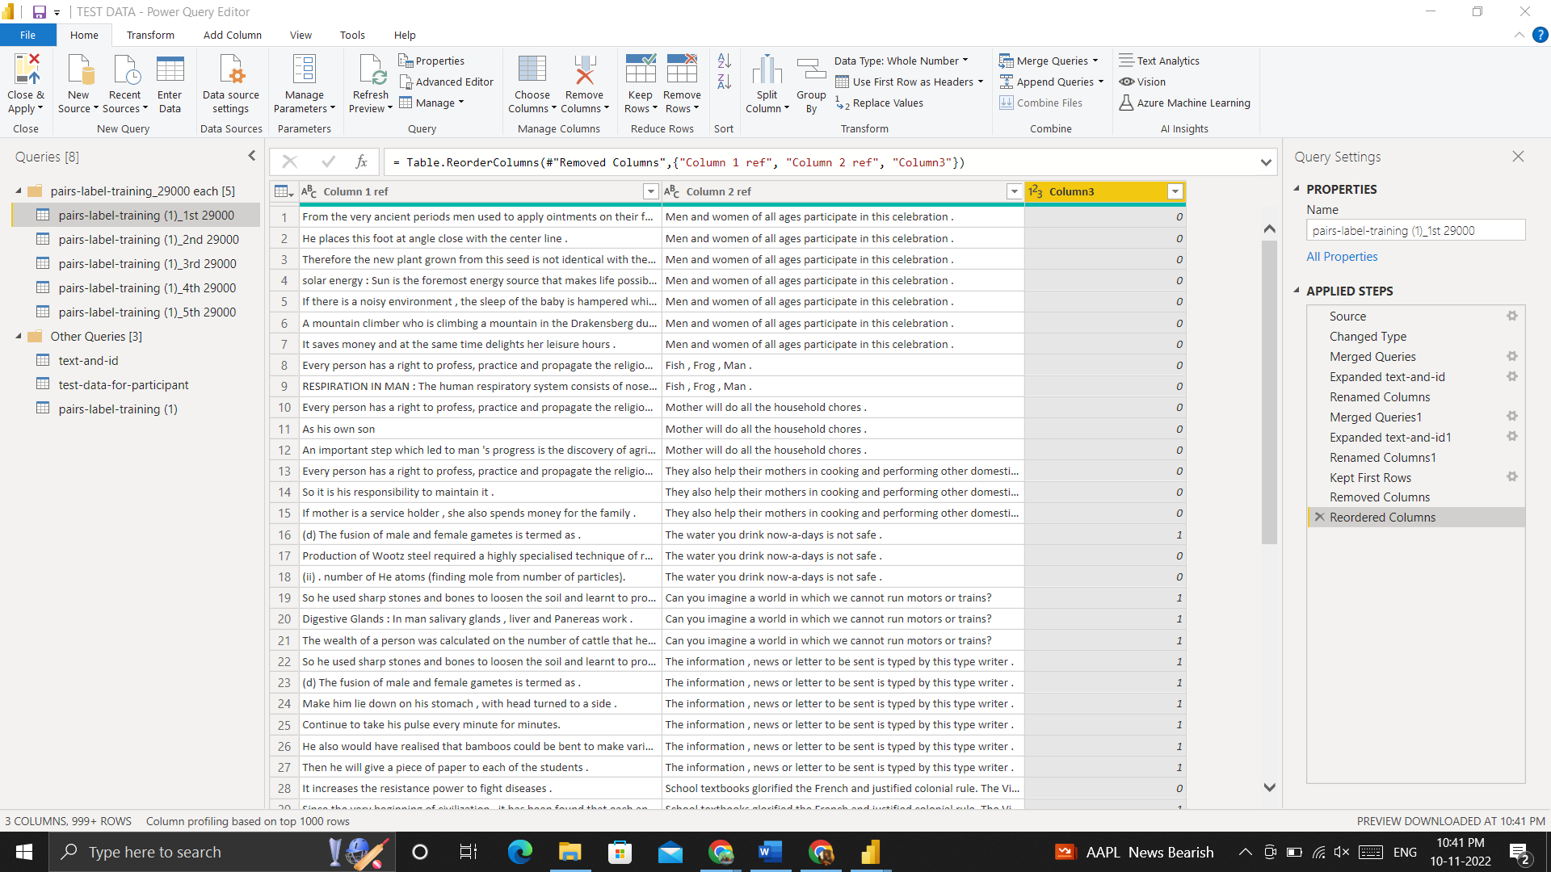
Developing the model - Data Cleaning
Matching test data with trained data

Slide 9
KNN Algorithm
Algorithms Used
Logistic Regression
NAIVE BASE

Slide 10
Pandas
NUMPY
Libraries Used
SKLEARN
MATPLOTLIB

Slide 11
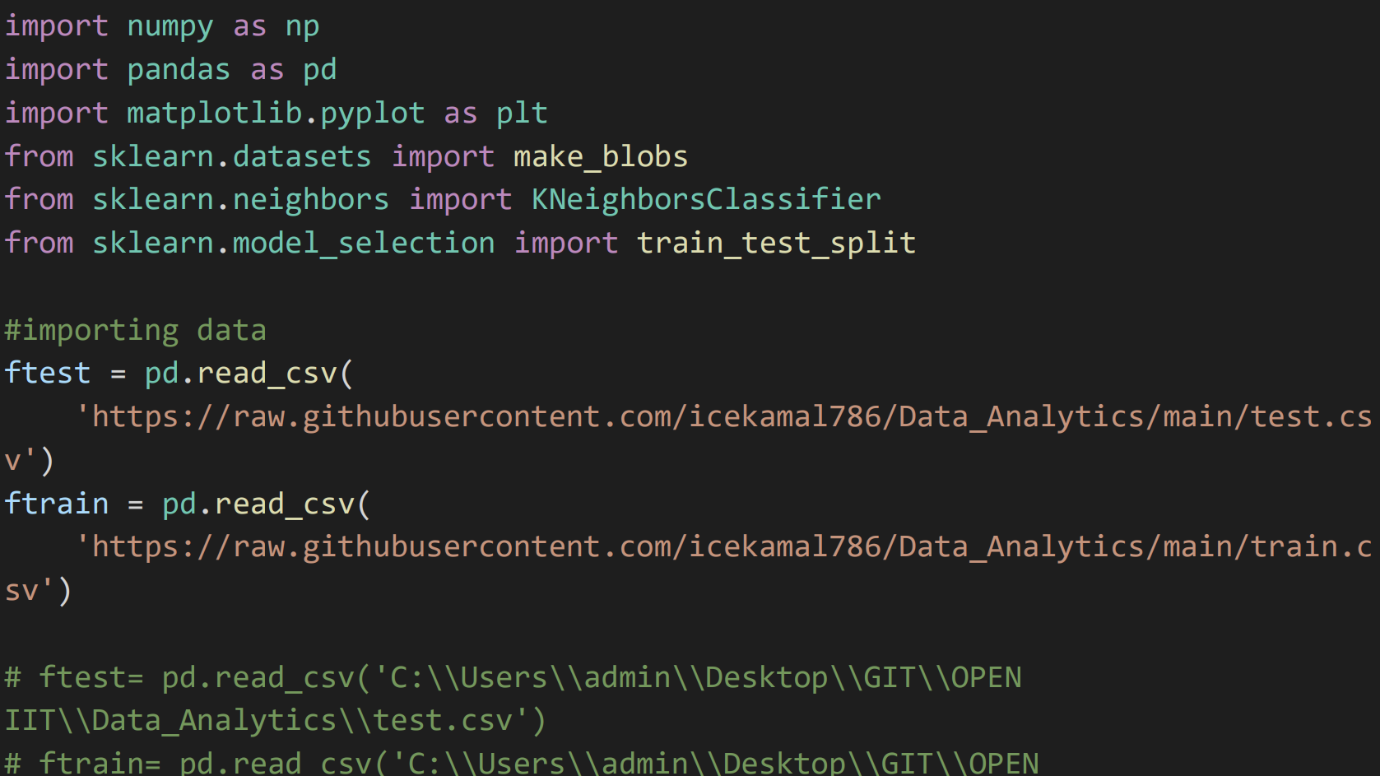
Developing the model - KNN

Slide 12
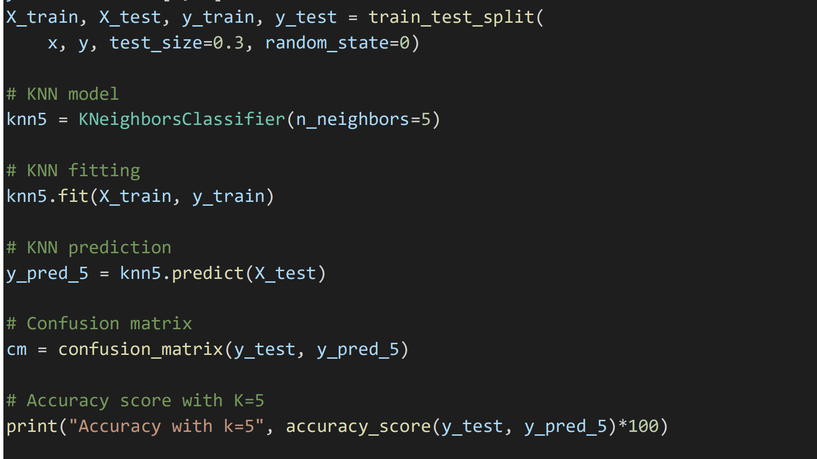

Slide 13
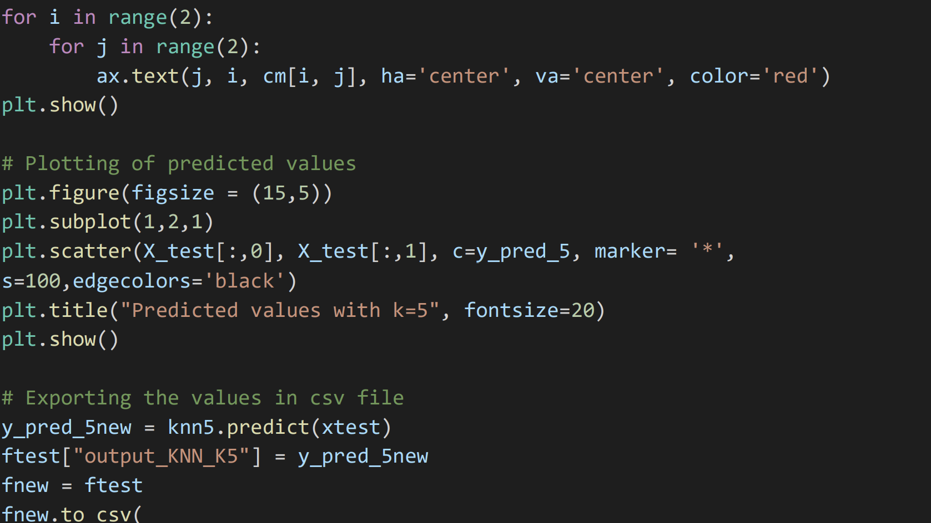

Slide 14
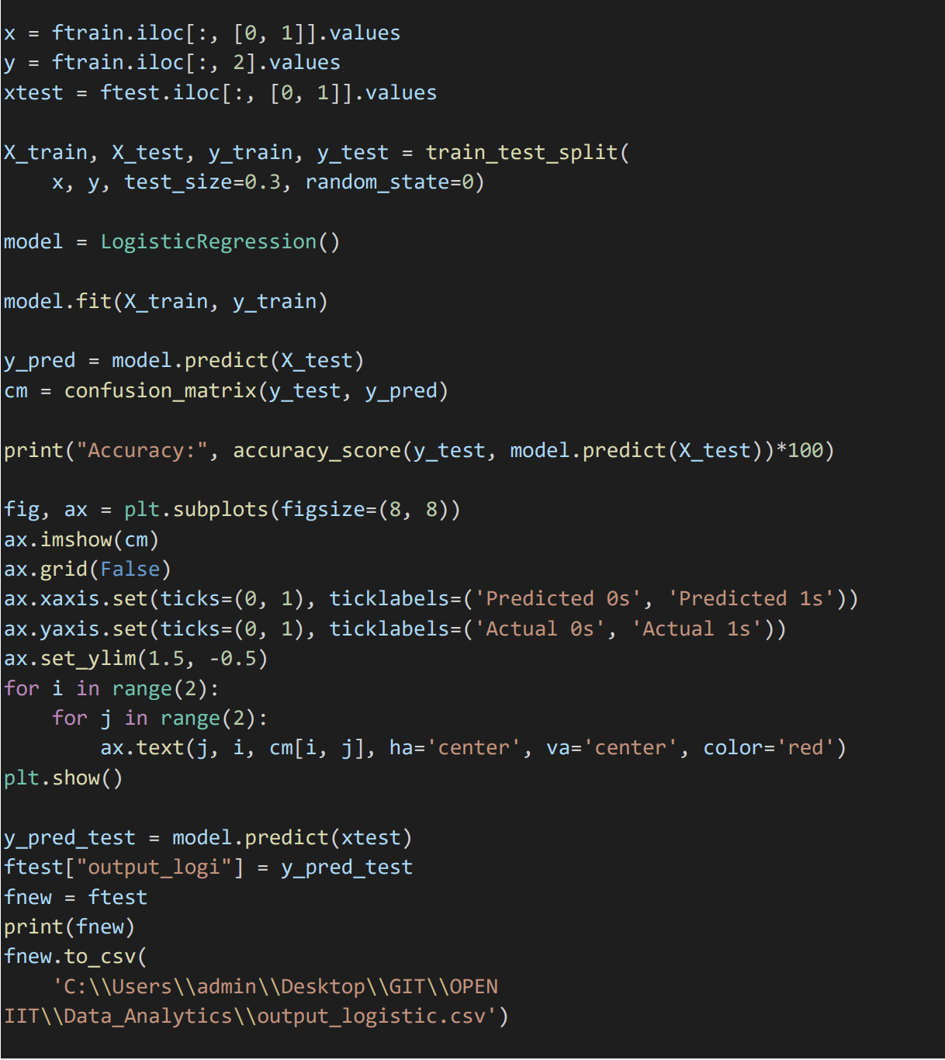
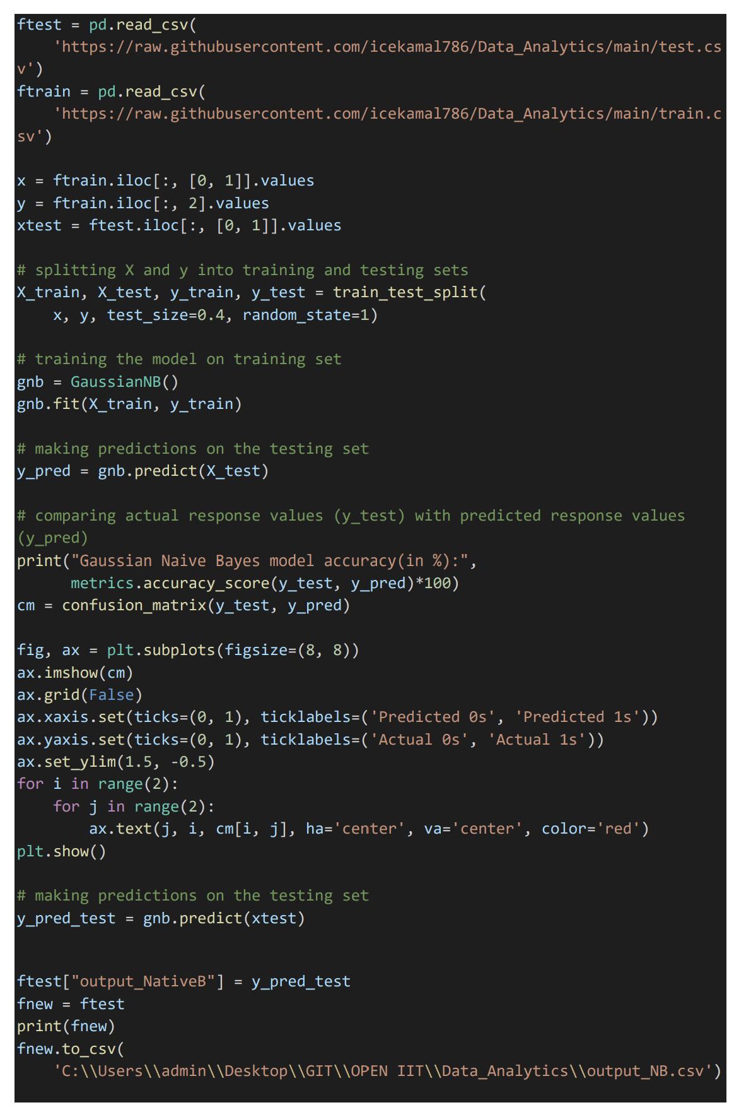
Logistic regression
Naive bayes

Slide 15
Result
Accuracy score
KNN - 0.999
Logistic - 0.993
Naive B - 0.997

Slide 16
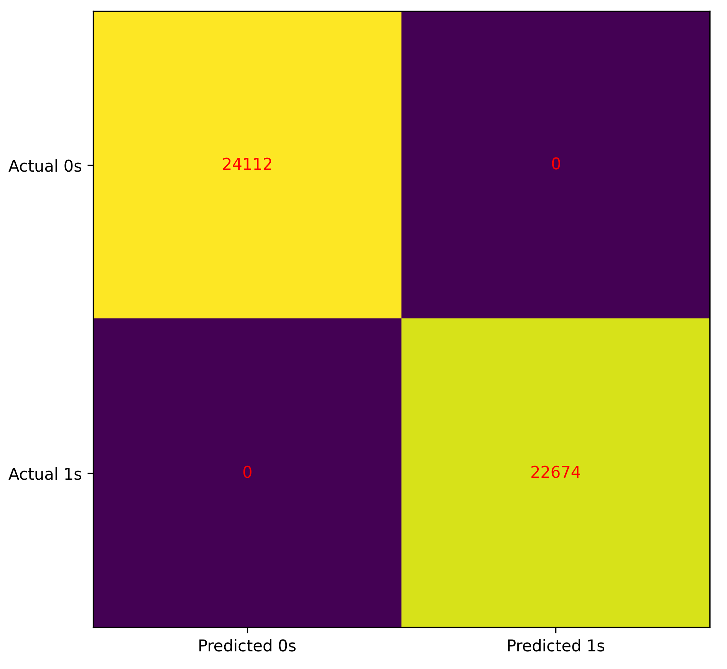
Confusion matrix
KNN

Slide 17
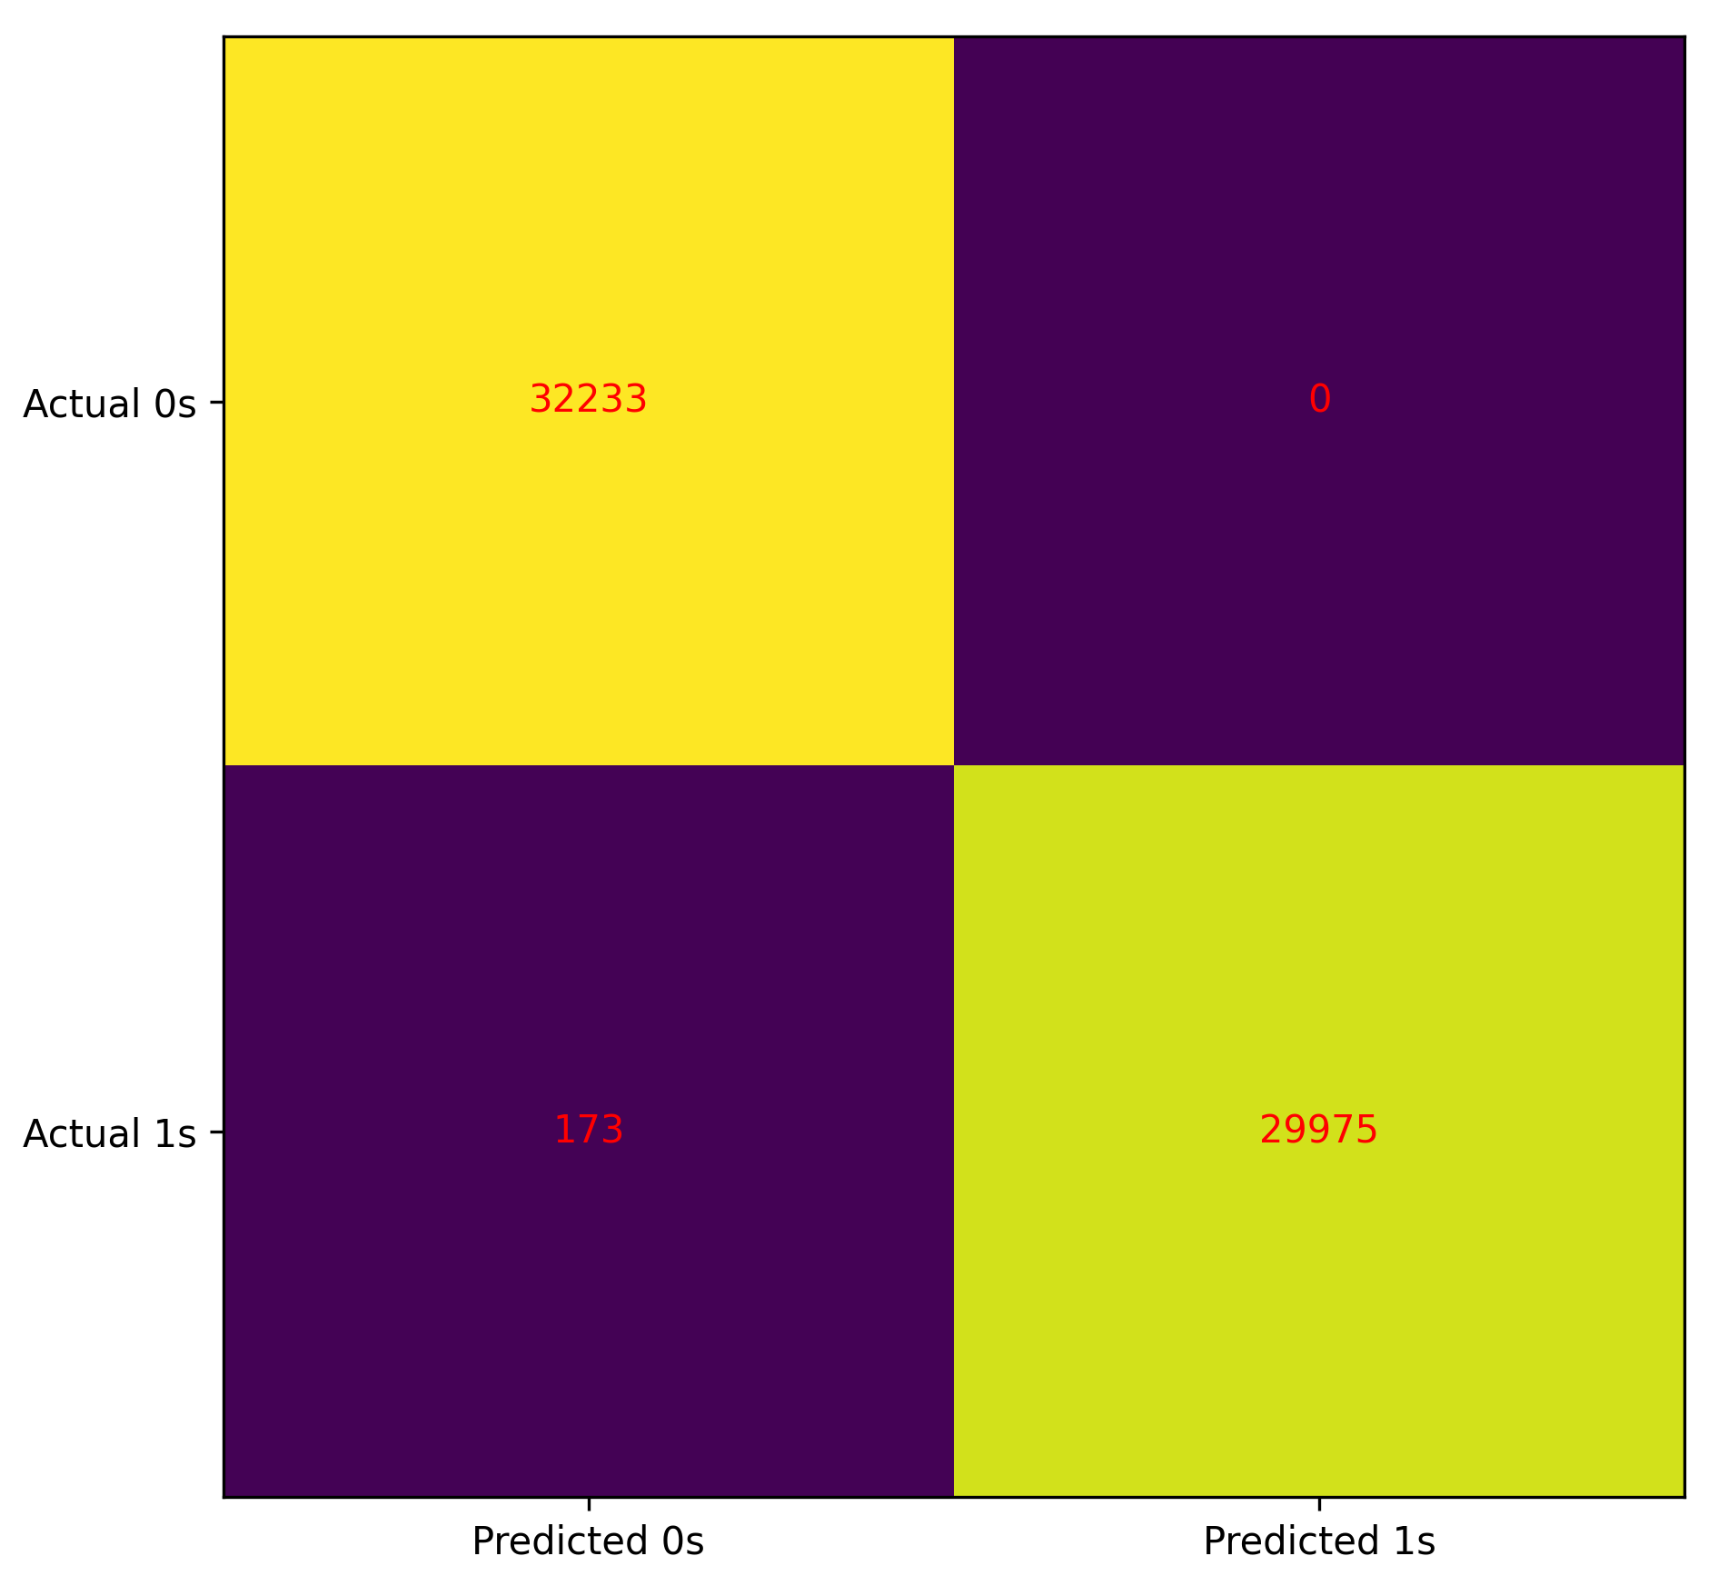
Confusion matrix
Logistic regression

Slide 18
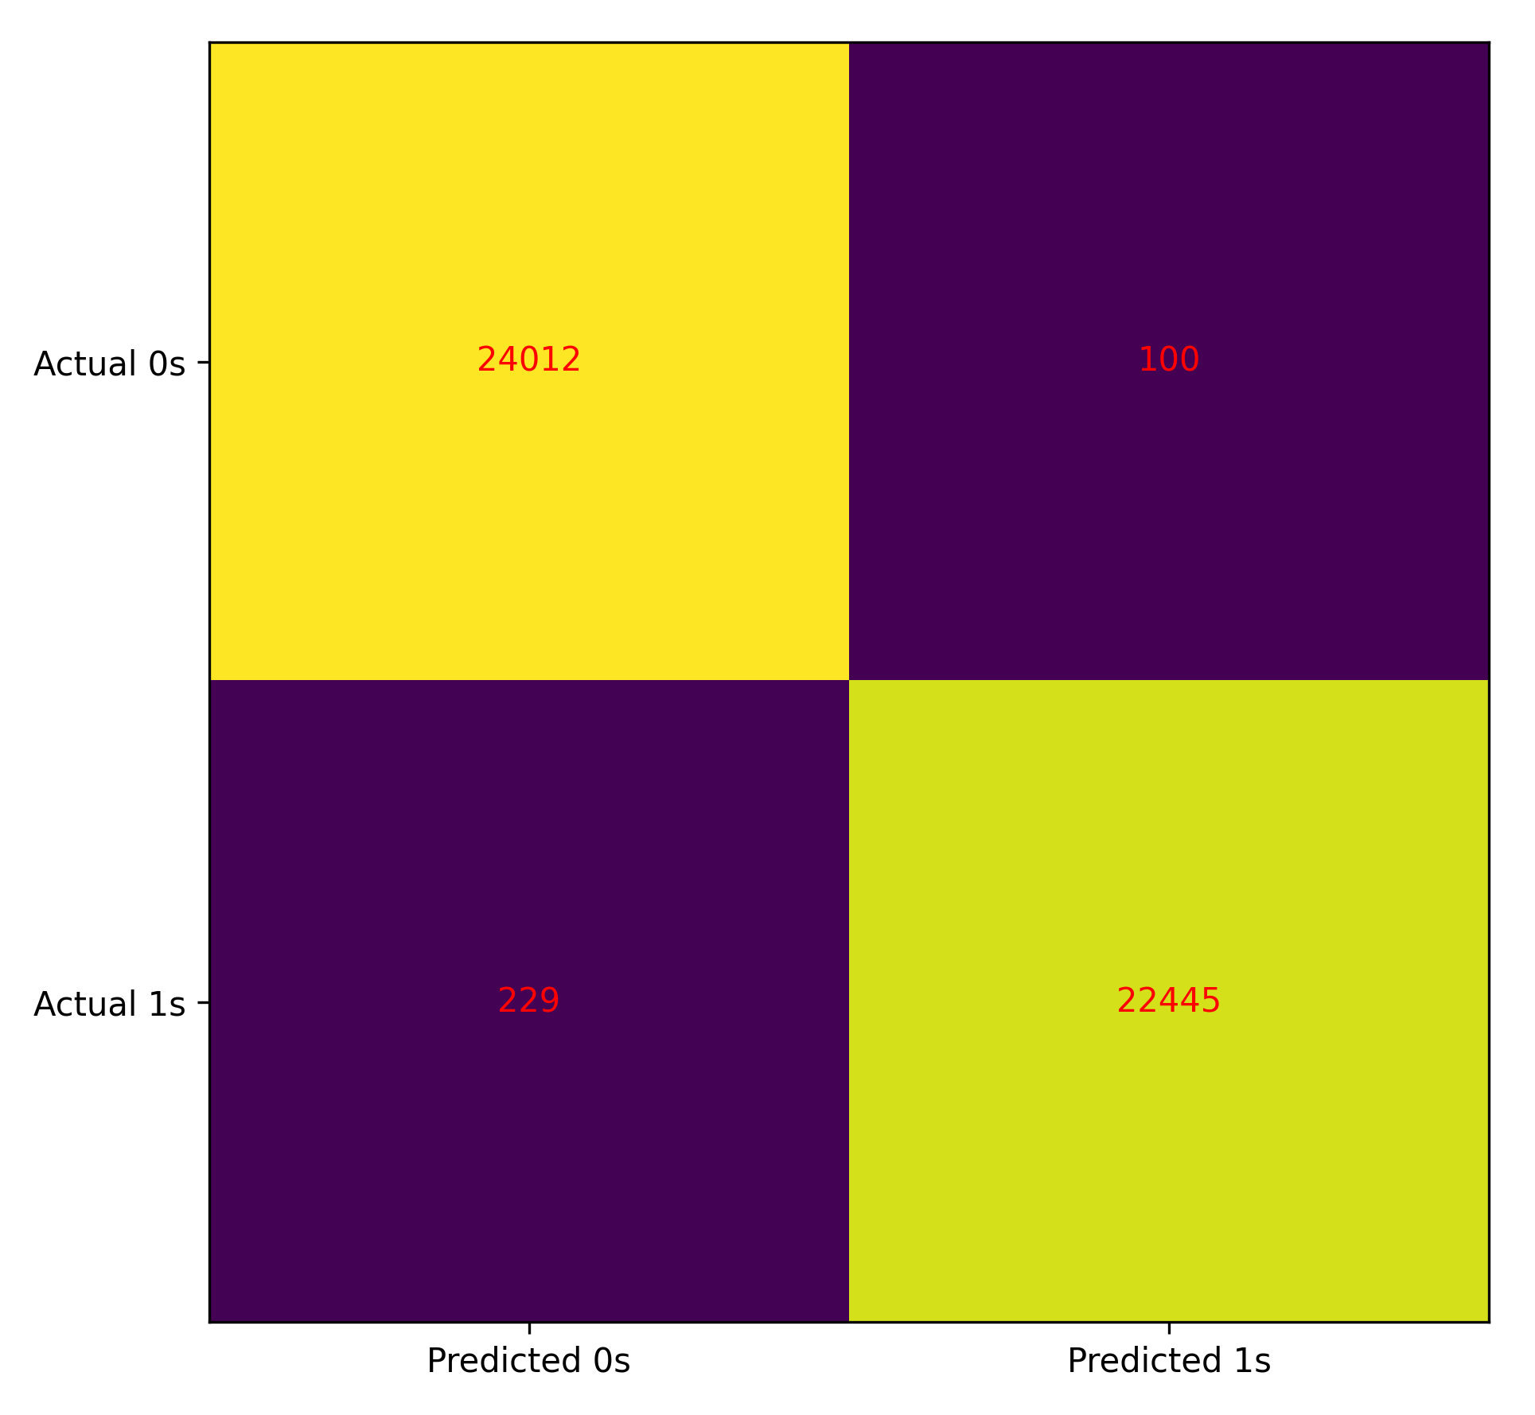
Confusion matrix
Naive bayes

Slide 19
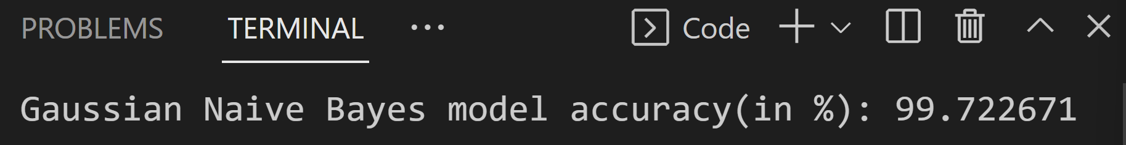
OUTPUTS:

Slide 20
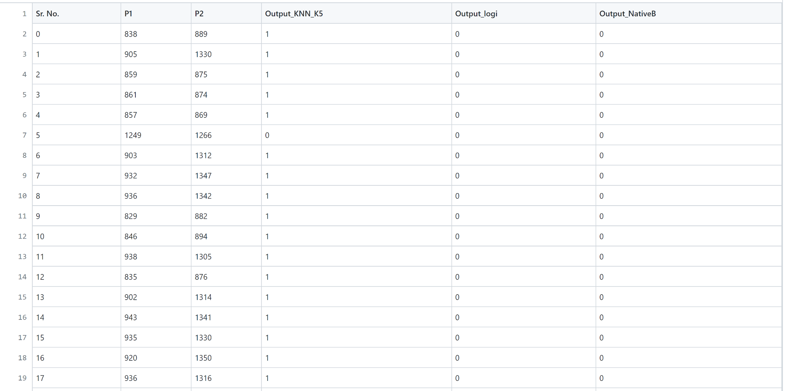
Output file:

Slide 21
References
Aylin Caliskan, Joanna J Bryson, and Arvind Narayanan. 2017. Semantics derived automatically from language corpora contain human-like biases. Science, 356(6334):183–186.
Kaytlin Chaloner and Alfredo Maldonado. 2019. Measuring gender bias in word embeddings across domains and discovering new gender bias word categories. In Proceedings of the First Workshop on Gender Bias in Natural Language Processing, pages 25–32.
Kai-Wei Chang, Vinod Prabhakaran, and Vicente Ordonez. 2019. Bias and fairness in natural language processing. In Proceedings of the 2019 Conference on Empirical Methods in Natural Language Processing and the 9th International Joint Conference on Natural Language Processing (EMNLP-IJCNLP): Tutorial Abstracts, Hong Kong, China. Association for Computational Linguistics.

Slide 22
Thank you

